Slide 1
Rare Pattern Mining using Rare Pattern Growth
Ian Smith

Slide 2
Introduction

Slide 3
What is Rare Pattern Mining
Rare Pattern Mining is the extraction of items and sets within a database which almost never occur
Rare Pattern Growth uses a Tree Structure to store potential item sets to mine them more efficiently

Slide 4
Technologies
Software written in C++
Compiled in G++ using Separate Compilation
Transaction databases represented by .txt
Simplest database contained 4 transactions
Up to 10 000
Notes:
Put together a C++ console application that compiles using Separate Compilation
The database txt files contain a list of transactions containing a transaction ID, the number of items, and a list of items contained in the transaction. The largest file contained ten thousand transaction, and the smallest contained only 4 (mostly for testing).

Slide 5
Alternative Approaches
Apriori
DHP
Partition
VIPER
Eclat
Notes:
Apriori, which is probably the most basic approach, involves pruning itemsets with a non-rare subset, and counting the support of candidate itemsets to ensure that they are rare
DHP, or Dynamic Hashing and Pruning, reduces the number of transactions to examine by using a hash table
Partitioning involves splitting the transactional database into n partitions, and examining each partition separately to find rare sets
VIPER and Eclat are both vertical mining algorithms, meaning that they use set or bitwise operations to combine rare itemsets to create candidate itemsets, and then counting the support using the bitmap/set

Slide 6
Description

Slide 7
Transaction Phase
Reads the database
Creates a list of Transaction objects
Adds the Transactions to a list
Notes:
The Transaction phase, simply put, reads in the database file and creates a TransactionList containing all the transactions that were in the file

Slide 8
Pruning Phase
Creates a table of all items in all transactions
Removes non-rare items
Sorts the table
Removes non-rare items from transactions
Removes empty transactions
Sorts transactions
Sorts transaction list
Notes:
The Pruning phase creates a set containing all the items in all the transactions, removes any item that isn’t rare, then sorts the set. Then the set is passed to the Transaction List so that the list can remove the non-rare items and then be sorted. Any empty transactions are also removed from the list. The transactions themselves are sorted as well so that the more frequent rare items can be placed near the top of the tree.
Quick Sort is used any time it was necessary to sort something in this project.

Slide 9
Construction Phase
Adds each transaction to the Rare Pattern Tree
Calls RPTree::add_transaction once for each transaction
The last time the transaction list is needed

Slide 10
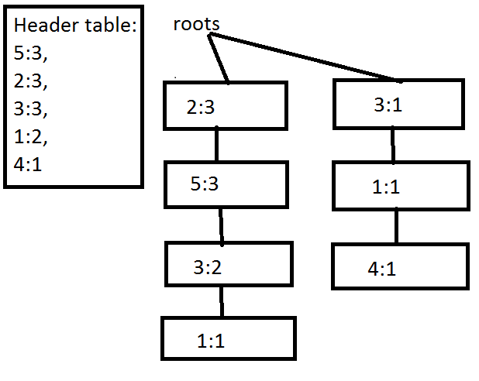
Notes:
This shows the second most basic tree put together by the software and its header table. This tree came from PreciseDB.txt, which was the simplest database used by the software. Notice that the tree structure here isn’t particularly balanced; however, I believe that placing the more common items at the top will help efficiency a great deal.

Slide 11
Mining Phase
Recursively mines the RPTree for rare item sets
Base case: returns the node and its support
Recursive case: Combines the child nodes to create a list of sets indicated by the current tree
Notes:
The Mining Phase recursively mines the tree to find all the rare itemsets in the database and their support. This is where the software stops building and starts examining/mining the database

Slide 12
PreciseDB Sets
Input file: Input/PreciseDB.txt
There are 19 patterns in this database with a support of 3 or less
{{2}: 3,
{3}: 3,
{5}: 3,
{1}: 2,
{1,5}: 1,
{5,3}: 2,
{1,3}: 2,
{1,5,3}: 1,
{3,2}: 2,
{5,2}: 3,
{1,2}: 1,
{1,5,2}: 1,
{5,3,2}: 2,
{1,3,2}: 1,
{1,5,3,2}: 1,
{4}: 1,
{4,3}: 1,
{4,1}: 1,
{4,3,1}: 1}
Notes:
This list is of all the rare itemsets in PreciseDB.txt. Since the max_support was 3, it also happens to be all the sets in PreciseDB.txt. Since the algorithm examines the children one at a time, starting with the first ones, you can clearly see where it moved to the next root in the tree (from 2 to 3).

Slide 13
PreciseDB Sets
Input file: Input/PreciseDB.txt
There are 3 patterns in this database with a support of 2 or less
{{1}: 2,
{4}: 1,
{4,1}: 1}
Notes:
This trial actually tried to find rare item sets in PreciseDB.txt. As you can see, with a max_support value of only 2, there are now only 3 item sets considered interesting by the software because 2, 3, and 5, all had 3 occurances.

Slide 14
Analysis

Slide 15
Success?
Absolutely
The application was successful with each transactional database it was given
No memory leaks according to valgrind
Notes:
There wasn’t any scenario I tried where the algorithm was unable to come up with a list of rare item sets. It could get slow depending on the max_support parameter, but if you have time then you can give it a shot. As the number of transactions increases, then the maximum support value should probably stay around the same number, or only get a little larger, going by proportion might take a long time.

Slide 16
Efficiency
Far more efficient than Apriori
Reduced the need to validate by the database many times over
No need for candidate sets
Pruning done in advance
Not as obvious with Eclat/VIPER
Notes:
The resulting application was far more efficient than Apriori or any of its modified versions that I am familiar with, simply because this software only needs to reads the database a constant number of times (I think 3 or 4), as opposed to each time the algorithm moves on to larger sets. I don’t believe DHP or Partition reduce this weakness in a particularly significant manner.
Eclat and VIPER are also more efficient than Apriori for Data Mining, but I believe they are less efficient than a growth algorithm for similar reasons. They have to progressively combine similar itemsets and then count the support in some way or another. With RPGrowth, this isn’t necessary. The support is determined by the rarest item in the set represented by that part of the tree, and the tree also determines which itemsets can be combined. The differentiator may be that VIPER and Eclat both use much simpler combine algorithms compared to Apriori or RPGrowth.
There is, however, more work for RPGrowth to do before actually examining the tree it builds. So for smaller itemsets, it may be considerably slower than Apriori or VIPER. For larger ones, I believe it is considerably faster.

Slide 17
Conclusion

Slide 18
Future Work
Would consider using clustering/classification
Determine max support programmatically
Not necessary to use Growth on small databases
Adapt for real databases
E.g., PostgreSQL
Display patterns
Notes:
In the future, I would certainly consider applying clustering/classification to the rare itemsets returned by the software to find the most interesting item sets
Could determine max_support programmatically, rather than passing it as a parameter and running muiltiple trials. In my experience, though, this leads to a considerable increase in complexity and the software taking much longer to do its job
There is no need to use a Growth approach on small databases (like PreciseDB.txt)
Might be an interesting experiment to adapt this software to work with real database software like PostgreSQL
Could display the patterns in a more aesthetically pleasing way, like a graph

Slide 19
Closing Thoughts
Successfully constructed a RPGrowth app
Recursively examines a tree structure to find rare patterns in various datasets
Examines the database the same number of times regardless of its size
Would be interested to see what happens with even larger datasets
Can most likely increase the efficiency and decrease complexity further
Notes:
Was able to successfully put together some software that finds rare patterns in a transactional database by using a tree structure and recursion, this allows the software to examine the database a constant number of times regardless of the size of the database.
I would be interested in seeing how the software would handle yet larger databases (e.g., 50 000, or 100 000 transactions)
Might be possible to increase efficiency and decrease complexity by delegating more work to the RPTree class, for example,

